Slide 1
ICF UKRAINE CHAPTER
ICF NEW CORE COMPETENCY #7
- From Creating to Evokes Awareness
«
During ICW, we encourage individuals and organizations all over the world to understand, explore, test and discover the possibilities coaching provides.
«
ICF COACHING WEEK 2021
1￼

Slide 2
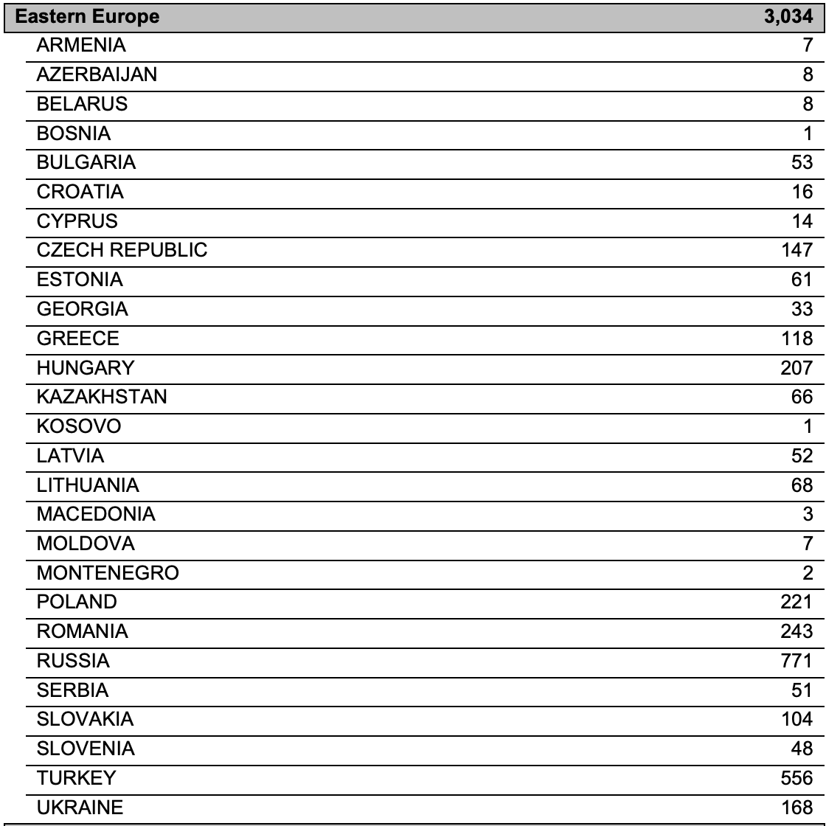
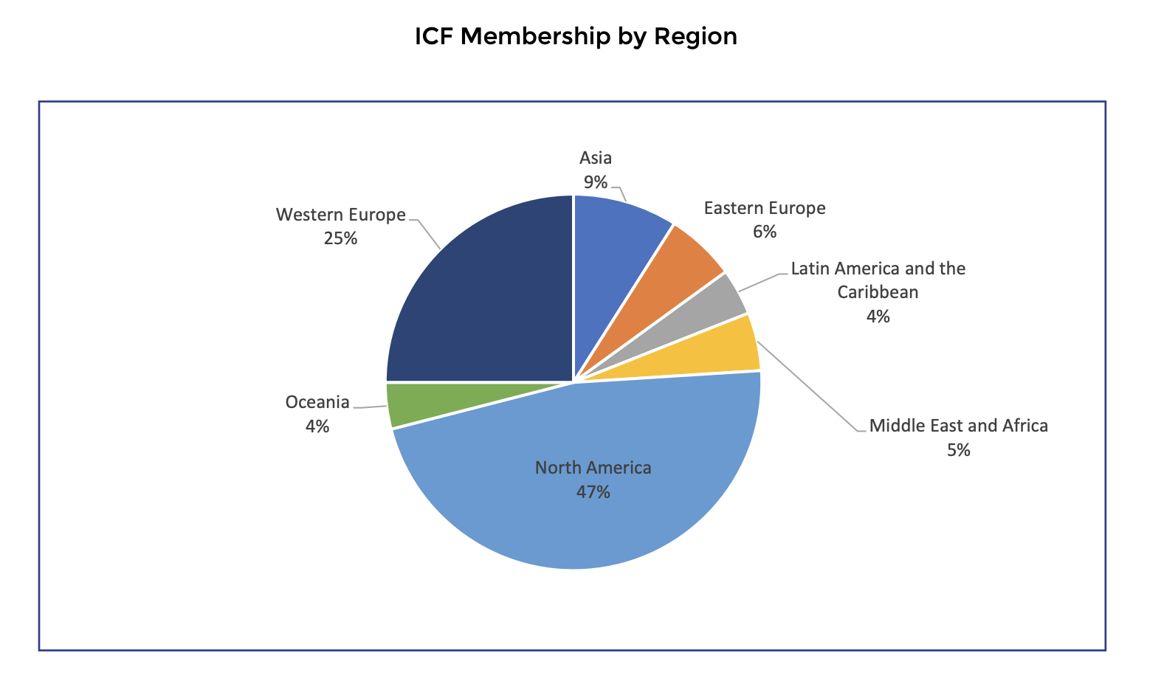
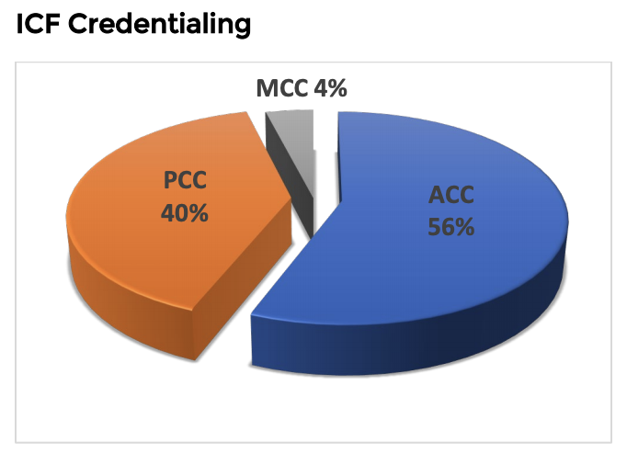
FROM CREATING TO EVOKES AWARENESS
GETTING TO KNOW YOU
https://coachingfederation.org/app/uploads/2021/05/May2021_FactSheet.pdf
ICF COACHING WEEK 2021
2￼

Slide 3
FROM CREATING TO EVOKES AWARENESS
TUNE UP
«ICF Credential-holders are part of a self-regulating group of elite coaches who provide accountability to clients and the coaching profession as a whole. They pursue and complete rigorous education and practice requirements that provide unquestioned legitimacy to their commitment to excellence in coaching.»
– ICF, Credentials
POLL #1:
Which ICF credentials are you holding?
POLL #2:
How long have you been coaching?
ICF COACHING WEEK 2021
3￼

Slide 4
FROM CREATING TO EVOKES AWARENESS
FUNDATION
1
DEMONSTRATES ETHICAL PRESENCE
Understands and consistently applies coaching ethics and standards of coaching.
2
EMBODIES A COACHING MINDSET
Develops and maintains a mindset that is open, curious, flexible and client-centered.
ICF COACHING WEEK 2021
4￼

Slide 5
FROM CREATING TO EVOKES AWARENESS
CO-CREATING THE RELATIONSHIP
3
ESTABLISHES AND MAINTAINS AGREEMENTS
Partners with the client and relevant stakeholders to create clear agreements about the coaching relationship, process, plans and goals. Establishes agreements for the overall coaching engagement as well as those for each coaching session.
4
CULTIVATES TRUST AND SAFETY
Partners with the client to create a safe, supportive environment that allows the client to share freely. Maintains a relationship of mutual respect and trust.
5
MAINTAINS PRESENCE
Is fully conscious and present with the client, employing a style that is open, flexible, grounded and confident.
ICF COACHING WEEK 2021
5￼

Slide 6
FROM CREATING TO EVOKES AWARENESS
COMMUNICATING EFFECTIVELY
6
LISTENS ACTIVELY
Focuses on what the client is and is not saying to fully understand what is being communicated in the context of the client systems and to support client self-expression.
7
EVOKES AWARENESS
Facilitates client insight and learning by using tools and techniques such as powerful questioning, silence, metaphor or analogy.
ICF COACHING WEEK 2021
6￼

Slide 7
FROM CREATING TO EVOKES AWARENESS
CULTIVATING LEARNING AND GROWTH
8
FACILITATES CLIENT GROWTH
Partners with the client to transform learning and insight into action. Promotes client autonomy in the coaching process.
ICF COACHING WEEK 2021
7￼

Slide 8
FROM CREATING TO EVOKES AWARENESS
MEETING YOUR EXPECTATIONS
Q&A
ICF COACHING WEEK 2021
8￼

Slide 9
FROM CREATING TO EVOKES AWARENESS
OLD #8 VS NEW #7
8
CREATING AWARENESS
Ability to integrate and accurately evaluate multiple sources of information and to make interpretations that help the client to gain awareness and thereby achieve agreed-upon results.
7
EVOKING AWARENESS
Facilitates client insight and learning by using tools and techniques such as powerful questioning, silence, metaphor or analogy.
ICF COACHING WEEK 2021
9￼

Slide 10
FROM CREATING TO EVOKES AWARENESS
COMPETENCY #7
Considers client experience when deciding what might be most useful.
Challenges the client as a way to evoke awareness or insight.
Asks questions about the client, such as their way of thinking, values, needs, wants and beliefs.
Asks questions that help the client explore beyond current thinking.
Invites the client to share more about their experience in the moment.
Notices what is working to enhance client progress.
Adjusts the coaching approach in response to the client’s needs.
ICF COACHING WEEK 2021
10￼

Slide 11
FROM CREATING TO EVOKES AWARENESS
COMPETENCY #7
Helps the client identify factors that influence current and future patterns of behavior, thinking or emotion.
Invites the client to generate ideas about how they can move forward and what they are willing or able to do.
Supports the client in reframing perspectives.
Shares observations, insights and feelings, without attachment, that have the potential to create new learning for the client.
ICF COACHING WEEK 2021
11￼

Slide 12
FROM CREATING TO EVOKES AWARENESS
TUNE UP
«PCC Markers are behaviors that represent demonstration of the Core Competencies in a coaching conversation at the Professional Certified Coach (PCC) level. These markers support a performance evaluation process that is fair, consistent, valid, reliable, repeatable and defensible. The PCC Markers should not be used as a checklist in a formulaic manner for passing the PCC performance evaluation.»
– ICF, PCC Markers
REFLECTION #1:
Identify your challenge.
REFLECTION #2:
Share the behavior you want to change.
ICF COACHING WEEK 2021
12￼

Slide 13
FROM CREATING TO EVOKES AWARENESS
UPDATED PCC MARKERS
7.1: Coach asks questions about the client, such as their current way of thinking, feeling, values, needs, wants, beliefs or behavior. 7.2: Coach asks questions to help the client explore beyond the client’s current thinking or feeling to new or expanded ways of thinking or feeling about themself (the who). 7.3: Coach asks questions to help the client explore beyond the client’s current thinking or feeling to new or expanded ways of thinking or feeling about their situation (the what). 7.4: Coach asks questions to help the client explore beyond current thinking, feeling or behaving toward the outcome the client desires. [Competency 2 - Coaching Mindset: 7.1]
ICF COACHING WEEK 2021
13￼

Slide 14
FROM CREATING TO EVOKES AWARENESS
UPDATED PCC MARKERS
7.5: Coach shares—with no attachment—observations, intuitions, comments, thoughts or feelings, and invites the client’s exploration through verbal or tonal invitation. 7.6: Coach asks clear, direct, primarily open-ended questions, one at a time, at a pace that allows for thinking, feeling or reflection by the client. 7.7: Coach uses language that is generally clear and concise. 7.8: Coach allows the client to do most of the talking.
[Competency 2 - Coaching Mindset: 7.5]
ICF COACHING WEEK 2021
14￼

Slide 15
FROM CREATING TO EVOKES AWARENESS
TUNE UP
«Mentor Coaching for an ICF Credential consists of coaching and feedback in a collaborative, appreciative and dialogued process based on an observed or recorded coaching session to increase the coach’s capability in coaching, in alignment with the ICF Core Competencies.»
– ICF, Mentor Coaching
ICF COACHING WEEK 2021
15￼

Slide 16
FROM CREATING TO EVOKES AWARENESS
TUNE UP
-Demonstrates equal partnership by being open, vulnerable and willing to take appropriate risks, for example, in providing feedback that may make one or both individuals uncomfortable.
-Listens on all levels: physical, intellectual, emotional and intuitive.
-Is aware of and allows for differences in style, culture, and language.
-Creates a safe and trusting space for the delivery of feedback, using a respectful, clear, judgment free tone.
ICF COACHING WEEK 2021
16￼

Slide 18
CONTACT
Rossella Pin
- ICF MASTER CERTIFIED COACH, REGISTERED MENTOR -
www.rossellapin.com
rossella@rossellapin.com
[https://www.linkedin.com/in/rossellapin/]

