Slide 2
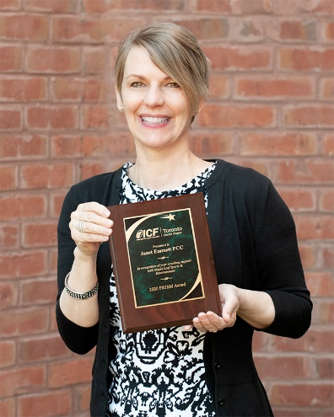
Janet Emmett is an ICF award winning, Executive Coach
Janet is an ICF accredited coach and certified Positive Psychology Practitioner (CAPP) through the Flourishing Center in NYC. Janet brings her passion for coaching and the use of evidence-based positive psychology practices in coaching to this webinar.
Janet works as an Executive Coach with individuals and teams in organizations. She often works in service-oriented organizations supporting her clients to provide excellent customer service and results.

Slide 3
Webinar Outcomes
Understand the neuroscience behind stress responses
Introduce the PERMA-V model highlighting pathways to flourishing
Learn some evidence-based practices that can support your coaching clients in difficult times
Become more aware of how to bring positive psychology tools into your coaching practice

Slide 4
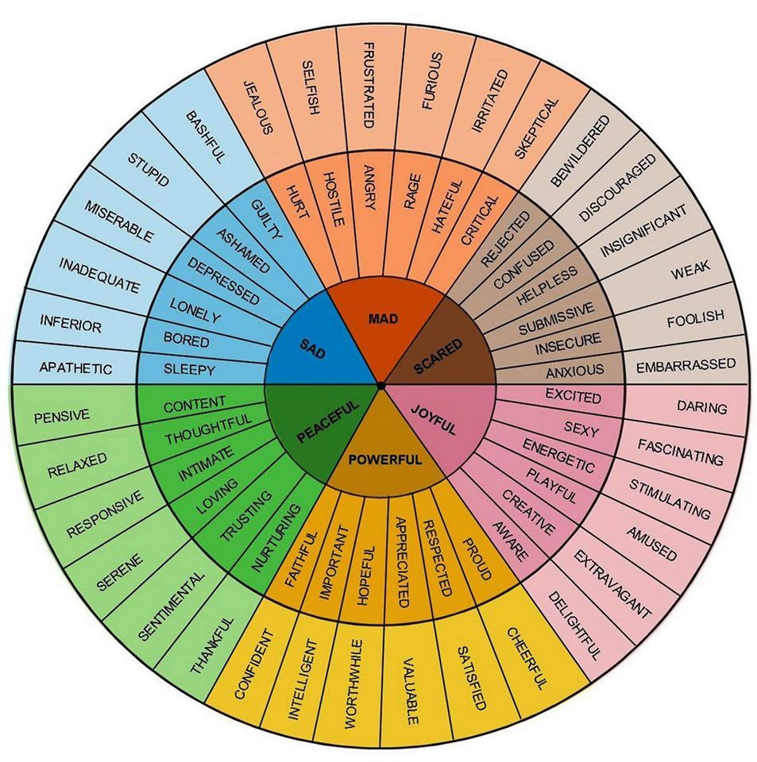
Which emotions are most present for you at this time?
Notice and name the emotions that seem to be most present for you at this time.
Select from the wheel and type in the chat what resonates most for you.
There are 34,000 words describing emotions. Researchers at Berkley, CA identified 27 categories. The basics are anger, fear, anxiety, joy, love, sadness, shame

Slide 5
Let’s Connect
Share in your group what it’s like for you to coach in these challenging times…
What’s going on for you as a coach?
What’s going on for your clients?
Appoint one person to record themes of your conversation.
Recorder types the themes into the chat when we return to large group.

Slide 6
The Current Reality
We're living in what researchers call a "super cycle" of transformation—a time when multiple seismic shifts are colliding and amplifying each other.
Futurist Amy Webb calls it an "Oh FUD" moment—that visceral feeling of Fear, Uncertainty, and Doubt that washes over us as we navigate a world in which everything feels increasingly unpredictable.
Our bodies have something to say about all this change, and they're not being subtle. When faced with this tsunami of transformation, we experience what mindfulness expert Jon Kabat-Zinn describes as "fundamental overwhelm"—when our lives unfold faster than our nervous systems can manage.
Source: Dr. Michelle McQuaid, From Functioning to Flourishing, Psychology Today Blog May 12, 2025

Slide 7
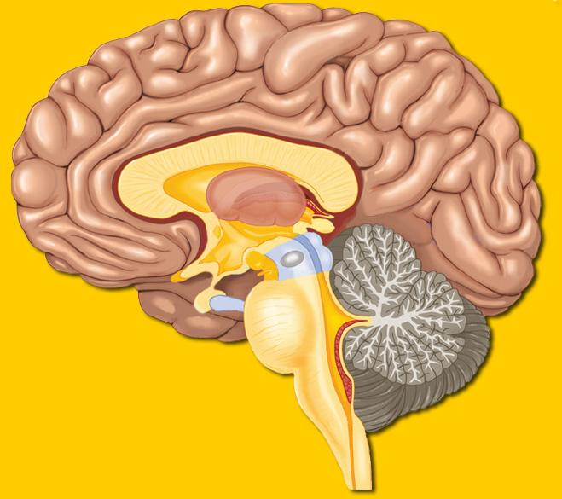
The Neuroscience of Stress
Prefrontal
(Executive and Logical)
Limbic System
Notes:
Goal: To increase understanding of the ‘brain’ processes that happen with coaching
Messages:
Three parts of the brain:
The Rest of the Brain is responsible for information, skills and knowledge. It is where it is stored and hard wired once it is learned and mastered. Your brain can access information stored here very rapidly, it can multi task and is incredibly fast. The act of recalling a memorized fact, solving a known problem happens very very quickly…the challenge comes when we run into something new…
The Prefrontal Cortex: This part of the brain is the electrician of the brain. It is activated when new information or new insight occurs. It is very slow compared to the rest of the brain and it can only handle 6 or 7 variables. Its job is to search for relevant information or experiences that it can attach new information to or create relevance out of a new experience or insight. When we ask someone a great question this part of the brain kicks in. Our challenge is to be silent long enough for this part of the brain to effectively do its job.
The Limbic System: More primitive … the reptilian brain ..simpler. It contains the …
Amygdala: (Emphasis on ‘myg’) The small organ that acts like a filter for incoming information. It analyzes info and – if necessary – fires up the fight, flight or freeze function and also routes info to the pre-frontal cortex if necessary. It also has a highly sensitive BS detector which is skilled at picking up BS. When coaching, it’s important to be careful expressing opinions or offering info that is not well backed-up and based in fact.

Slide 8
The Stress Response
When we perceive a stressor it triggers an area of the brain called the amygdala which sets off a cascade of physiological changes to help prepare the body to fight, flight or freeze;
releasing adrenalin,
increasing heart and breathing rates,
increasing blood supply to the muscles,
enhancing reflexes and dilating the pupils,
less sensitive to pain,
and our thinking becomes narrower (important to attune to in coaching)

Slide 9
The Stress Response - fight, flight or freeze
If we have a physiological (body) response to a psychological (mind) threat….too often
Change/Uncertainty = Stress
Our automatic default is to register a ‘surprise’ or uncertainty as a threat
Our amygdala is our center of hyper-vigilance unless we tell it otherwise
(Source: Rock and Ringleb, 2013)

Slide 10
Stress & Perception – Busting Stress
“Between stimulus and response there is a space.
In that space is our power to choose our response.
In our response lies our growth and our freedom”
(Source: Viktor Frankl , Man’s Search for Meaning)
“The greatest weapon against stress is our ability to choose one thought over another….”
(Source: William James, early Psychologist)

Slide 11
Psychology 101 in Perspective / Mindset
Post in the chat what you see
See if you can shift it
Experience how it’s a conscious choice…

Slide 14
Ways of Being as a Coach in Times of Uncertainty and Stress
Just like our clients, we too are distracted and that can play out in our coaching.
How do we need to show up or be? Intention and Attention…
Centred Presence – are you listening, focused, not distracted?
Radical Listening – are you listening for emotion, self-judgement, negative expressions of thoughts, not just what is said?
Reframing Beliefs & Thoughts – are you supporting your clients to reframe mindsets & perspectives which might not be helpful?
Specific Acknowledgement – are you acknowledging the hard work & progress your clients are making? Not just once, but often.
Sharing resources and tools – are you a conduit to tools and resources that can support busting stress and building capacity & competence?

Slide 15
Let’s Connect In the Chat
How do you think you need to show up right now for your clients?
“Show up in every single moment like you’re meant to be there”
- Marie Forleo

Slide 16
Positive Psychology - PERMA-V Model
YOU + Your Workplace
Source: Reprinted with permission from The Flourishing Centre – NYC

Slide 17
Evidence-Based Positive Psychology Practices to Bust Stress and Boost Resiliency

Slide 18
Positivity is Key for Resilience & Busting Stress
Practice #1 – Positivity
As coaches, we can support our clients to broaden and build their positive emotions, or feel-good emotions like joy, love, happiness, kindness, compassion, hope, optimism.

Slide 19
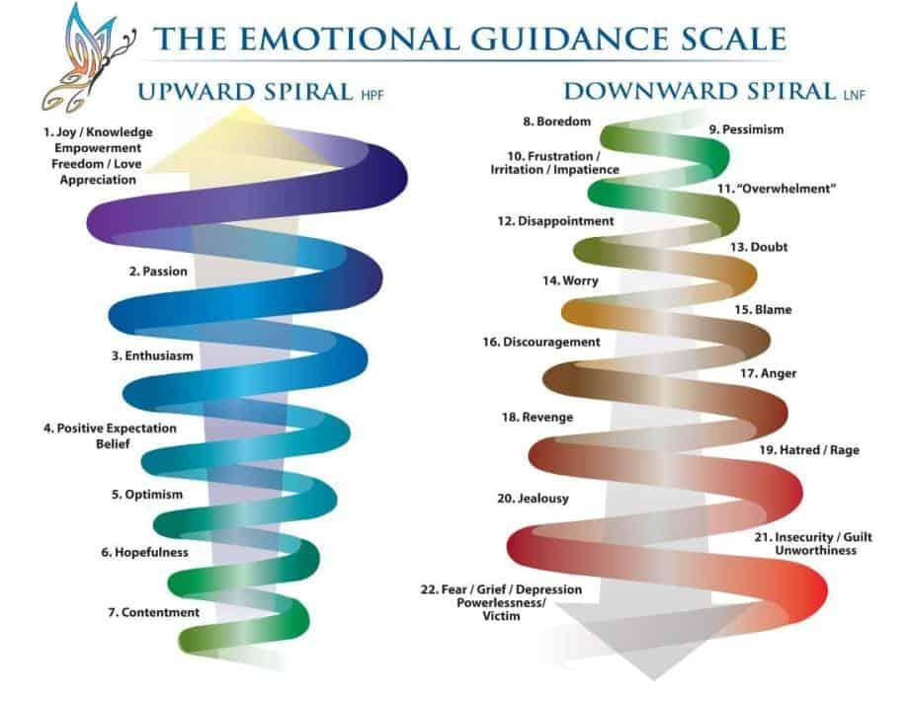
Positive vs. Negative Mind Chatter
Emotional Mastery
Broaden and
Build
Narrow and
Focus
Acknowledge your clients’ insights, learnings, & how they are showing up to you
Support your clients to reframe negative thoughts and inquire into judgements you hear
Notes:
Negative thoughts
Slow down brain coordination
Make it difficult to process thoughts or find solutions
Hinder creative ability
Decreases activity in the cerebellum
Impact the left temporal lobe (fear factor)
affecting mood, memory and impulse control
Positive thoughts
Synapses (areas connecting neurons) increase dynamically
Increases mental productivity by improving cognition
Intensifies ability to pay attention, to focus
Improves ability to think and analyze incoming data

Slide 20
Practice #1 – Positivity and Managing Mind Chatter
Most people don’t take the time to question their mind chatter.
They assume if it came from their mind, it must be true.
They don’t realize that they would never be that, mean, cruel, judgmental or pessimistic towards others, but they are that way towards themselves.
Support your client to take their mind chatter to court – what evidence is there that what they are telling themselves is true?
We can highlight the self-judgement we hear, inquire into the beliefs of our coachee’s, and support them to reframe negative thoughts and beliefs empowering them to shift their foucus

Slide 21
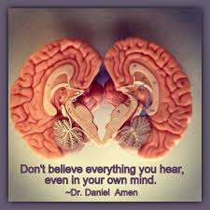
Real Time Reframing
When we hear negative perspectives
often caused by self judgement we can inquire
and support our clients to reframe their thoughts.
After all, a thought is just a thought.
It does not have meaning until our client puts meaning to it.
What might not be true about this?
What’s another way of seeing this?
What evidence do you have that this is true?
What’s the most likely outcome of this belief/assumption/perspective?
How might this belief be getting you unintended consequences?

Slide 22
Affirmations build Positivity
How are you supporting your clients to affirm and acknowledge themselves including; their strengths, progress, talents and efforts?

Slide 23
Manage Negativity With Affirmations
I am strong, capable and resilient.
I can lean into this as a learning opportunity to take into the future.
I am prepared to take every challenge as an opportunity.
I choose to find the silver lining in this situation.
I can achieve my goals and dreams no matter what comes my way.
Today is an awesome day – another chance for me to shine and share my gifts.
Ask your clients to affirm themselves….
I am…….
I choose…
I can……

Slide 24
Practice #2 – Fostering Gratitude
Shift your mind-energy to focus on the good of what is… instead of the upset of what is not

Slide 25
Practice #2 - Interrupting the Stress Response Through Gratitude
When we are feeling stressed, we tend to only focus on what is challenging in our lives which can increase our stress levels in a negative cycle
Gratitude helps to shift our focus to what is going well in our lives
Savouring what is going well in our lives can help to increase our sense of optimism, lower our blood pressure, positively impact our immune system, have more energy & decrease depression
Interrupts the stress response
Gratitude Exercise:
Write 3 things that you are grateful for. Be descriptive.
Do this every day. Ask your clients to notice
how they feel in body and mind after doing this
(Source: Emmons & McCullough, 2003)
You get an upward spiral from gratitude.

Slide 26
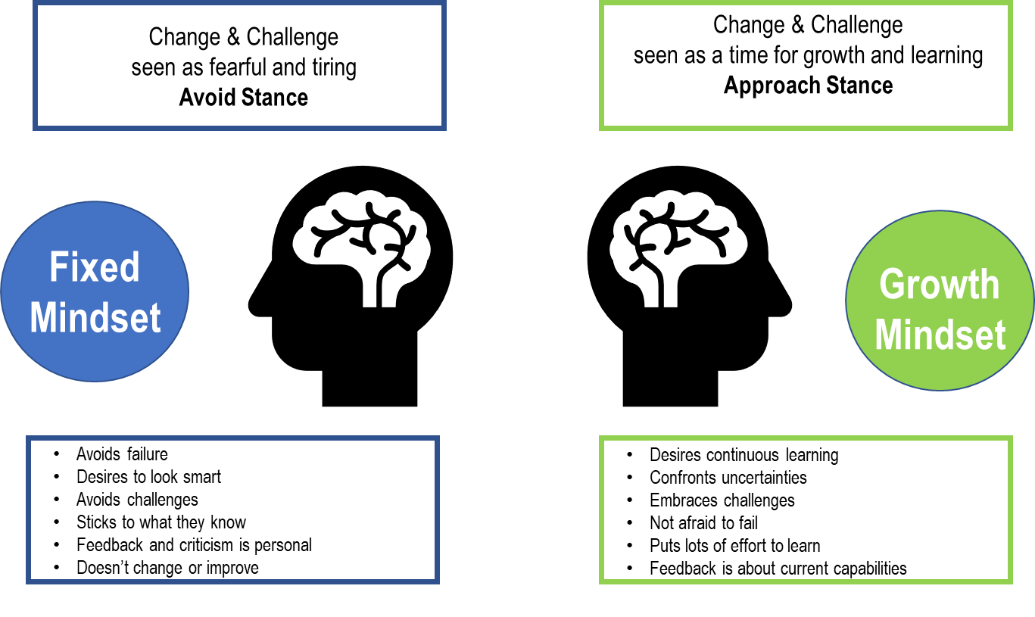
Practice #3 - Growth vs Fixed Mindset

Slide 27
Practice #3 - Growth vs Fixed Mindset
Shifting to a Growth Mindset…
Calms the amygdala (fear/vigilance response)
Helps you to lean into change
Increases creative problem-solving during uncertainty
Lowers stress
Increases optimism
Encourages teamwork (pro-social behavior)
Helps you to stretch your ability to appreciate by adopting a learning mindset
Coaches can listen for signs of fixed mindset and support clients to shift from an Avoid Stance to an Approach Stance by asking questions to reframe beliefs, assumptions and fears.

Slide 28
Practice #4 - Purpose & Meaning
Purpose is an overall sense of goals and direction in life
Meaning is more subjective – a feeling that life fits into a larger context, has significance and that life matters – makes a difference – has value
The two are strongly correlated
Purpose-driven leadership helps create a shared sense of direction, alignment, and commitment and fosters greater performance, persistence, and belonging at the organization. In fact, purpose is often one of the main drivers of employee engagement and satisfaction
Purpose-driven leaders are more likely to develop and maintain strong relationships with their direct reports and are better equipped to navigate leadership challenges and rapid change
(Research conducted by the Centre for Creative Leadership 2023)
“Those who have a 'why' to live, can bear with almost any 'how’.”
― Viktor E. Frankl
Man's Search for Meaning

Slide 29
Practice #4 - Fostering Purpose & Meaning
Whether you are a life or executive coach, supporting clients to create and connect to their life purpose, beliefs, values and goals will add huge value to your coaching.
How often are you inquiring into how the person you are coaching is aligning to their personal and/or organization’s Purpose, Goals, Beliefs and Values?
How strongly are you supporting your client to articulate out loud their purpose as a leader? How are you supporting them to define their leadership brand?
The more defined a leader can be about their purpose, values and motivations – the more their strengths will shine and they feel they belong to the organization and/or community.
Our motivations are the anchors to our behaviours. The clearer we are about our motivations the more our strengths shine
Source: Centre for Creative Leadership

Slide 30
Practice #5 - Acknowledgement
Acknowledgement builds positivity, confidence and delivers feel good chemicals (dopamine) to the brain.
People need feedback. They need acknowledgement of what we see in them. Even if they think they don’t need it – they will have a brain benefit from the feedback. The more specific, the better the impact on future behaviours.
It’s critical for coaches to acknowledge what they see in their clients – their strengths, characteristics, qualities, achievements, successes, goals, progress. Especially in times of overwhelm when individuals may doubt themselves and their abilities. Imposter Syndrome seems to be a more common belief amongst leaders. They do not feel equipped to handle the world’s uncertainty.
Acknowledge often in coaching sessions.

Slide 31
In Summary…
Your clients may be in a state of overwhelm or uncertainty.
How do we need to show up or be?
Give Intention and Attention to…..
Centred Presence – are you listening, focused, not distracted?
Radical Listening – are you listening for emotion, self-judgement, negative expressions of thoughts, not just what is said?
Reframing Beliefs & Thoughts – are you supporting your clients to reframe mindsets & perspectives which might not be helpful?
Specific Acknowledgement – are you acknowledging the hard work & progress your clients are making? Not just once, but often.
Sharing resources and tools – are you a conduit to tools and resources that can support busting stress and building capacity & competence? (e.g. Gratitude, Affirmations, Purpose Definition)

Slide 32
Closing Reflection
What’s a takeaway or insight for you?
What is something you might try that is different for you?
On a piece of paper draw a symbol, or write a 4-word mantra to remind you of how you want to show up for your clients right now.

Slide 33
For more information contact: Janet Emmett, CEC, PCC Principal Consultant + Executive Coach Janet Emmett, CEC, PCC | LinkedIn (send me a DM) emmett + associates

