Slide 2
Competence 4
Cultivates Trust & Safety

Slide 3
Program
Introduction
Starting Exercise
Exercise Competence 4
Competence 4 PCC Markers
Exercise
Gather Insights and facilitating growth

Slide 4
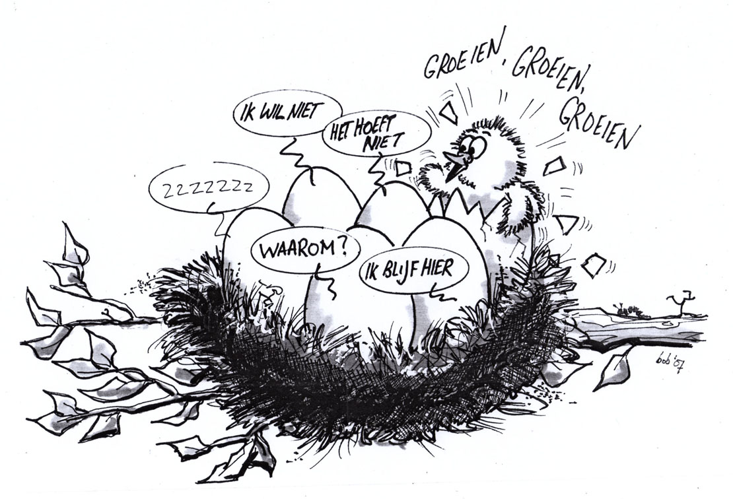
Introduction
Notes:
Aandacht voor de opname die gemaakt wordt
We werken vandaag met echte casussen dus passen mag.
Aandacht voor Veiligheid, zijn er nog dingen die gezegd dienen te worden om met elkaar te kunnen werken?
Introductie Onszelf en AvC
As you can see, a recording is being made, and I believe you agreed to this recording when you registered or logged in. If you do not agree, we kindly ask you to leave the webinar. The recording is made for participants who cannot attend and wish to watch the webinar later.
Today, we are working with real case studies and development issues. We will share genuine experiences, which means you are also free to pass if you feel the need. Finally, I would like to ask if there is anything else that needs to be said in order for us to work together effectively in today's webinar?

Slide 5
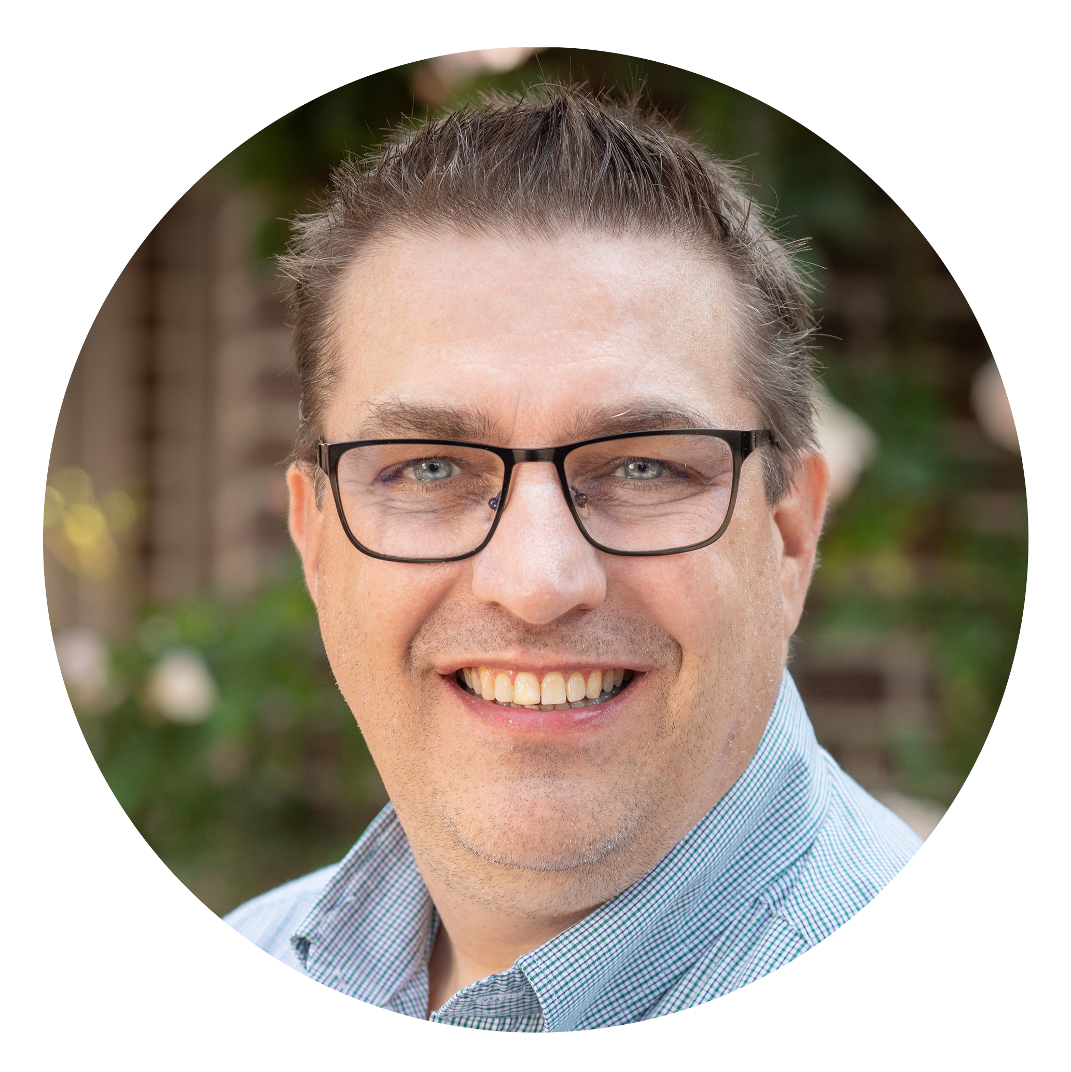
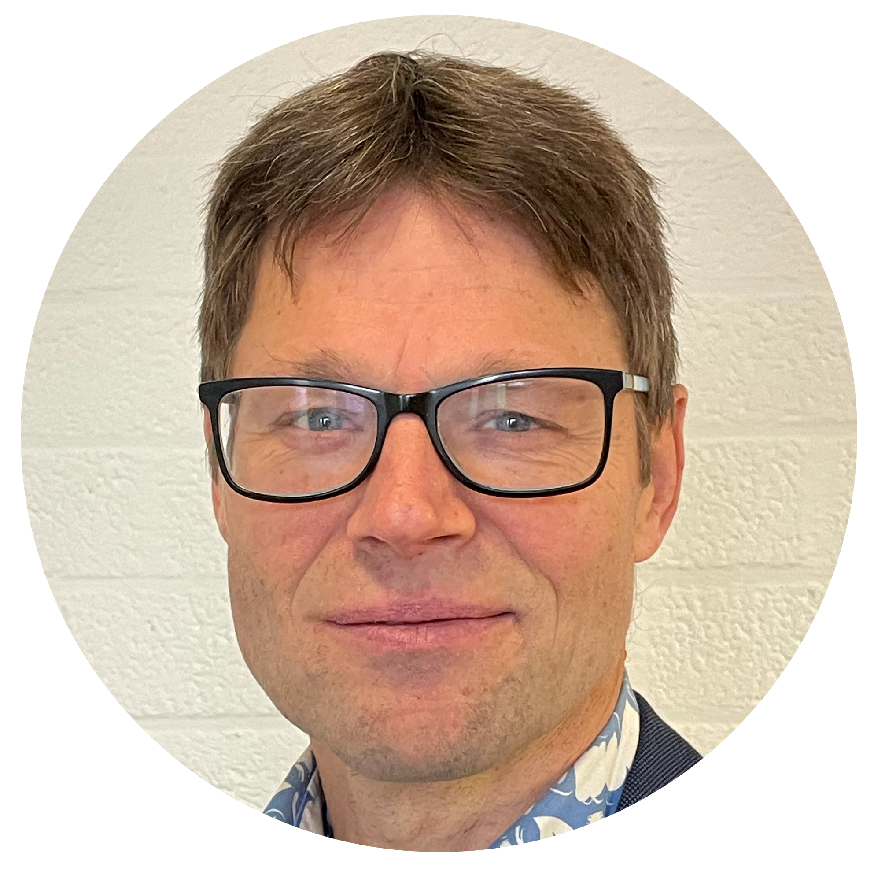
Dirk Verhoeven PCC / SP / ESIA
Charles Ruiters MCC / SP / ESIA

Slide 6
Warming up Exercise
On a scale from 0 to10, what level of cultivating trust and safety do you think you create when you have a first (intake) session with a new client?
Notes:
Met deze vraag gaat iedereen aan de slag om te delen hoe ze dit doen.
We gaan in de oefening waarschijnlijk van smal naar breed. Velen zullen deze vraag zien vanuit het perspectief van de coaching. Trek hem eens breder richting werk, het leven, je gezin, je familie etc. (Coachen doe je altijd en overal)

Slide 7
Warming up Exercise
What are your ways in cultivating trust & safety?
How do you create and cultivate trust & safety?
Notes:
Met deze vraag gaat iedereen aan de slag om te delen hoe ze dit doen.
We gaan in de oefening waarschijnlijk van smal naar breed. Velen zullen deze vraag zien vanuit het perspectief van de coaching. Trek hem eens breder richting werk, het leven, je gezin, je familie etc. (Coachen doe je altijd en overal)

Slide 8
Exercise
Breakout Rooms peer2peer coaching:
The one with the shortest hair will be the coach, the other one is client.
Have a real intake coaching session with your new (potential) client running for 10 minutes -
As coach focus on maximizing trust and safety for your client.

Slide 9
Exercise – Expanding Awareness
After the coaching session, client reflects on and shares:
What worked to cultivate trust & safety?
What would you have needed to reach a higher level in trust?
What did you noticed the coach did non-verbally to cultivate trust?
What else could have been done, said or altered to raise trust and safety?
You have 10 minutes for reflecting on the session

Slide 10
Cultivates Trust & Safety
Partners with the client to create a safe, supportive environment that allows the client to share freely. Maintains a relationship of mutual respect and trust.

Slide 11
PCC Markers
The coach…
4.1. acknowledges and respects the client’s unique talents, insights and work in the coaching process 4.2. shows support, empathy or concern for the client 4.3. acknowledges and supports the client’s expression of feelings, perceptions, concerns, beliefs or suggestions. 4.4. partners with the client by inviting the client to respond in any way to the coach’s contributions and accepts the client’s response.

Slide 12
Exercise
Review the PCC markers for competence 4 in subgroups, using the following questions:
What questions can you come up with for each marker?
What interventions can you come up with for each marker?
What tools & techniques can you use for each marker?

Slide 13
Exercise
Please share what new insights did you take away from your subgroup exploration & conversation

Slide 14
Facilitating Growth
What have you learned about Competence 4?
What have you learned about yourself?
What else have you learned?
How will you anchor these insights into your behavior?

Slide 15
Completion
What could we have done more to raise the level in trust & safety you have experienced during this workshop?

